Slide 1

CSC380: Principles of Data Science
Introduction and Course Overview
Xinchen Yu

Slide 2

Course instructor
Xinchen Yu
xinchenyu@arizona.edu

Slide 3
Outline
Data Science Introduction
What is data science?
Case studies
Course Overview
Resources
Grading policy
What you will learn

Slide 4
Data Science Introduction

Slide 5
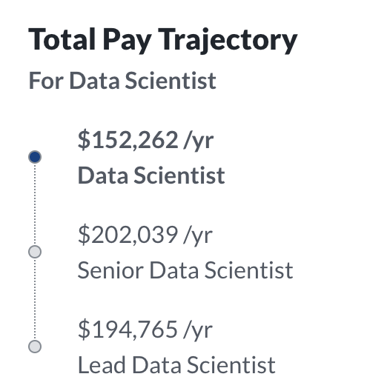
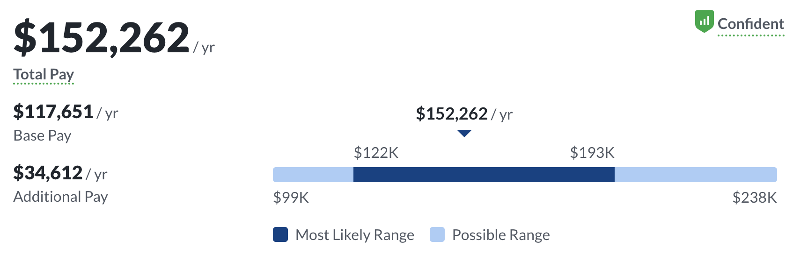
Data Science Job Market
A search of “data scientist” jobs in the US (on 8/20/2021) shows…
Many job options available
Indeed: 42,000+ jobs
Glassdoor: 24,000+ jobs
LinkedIn: 63,000+ jobs
2022’s #3 best job in America, according to Glassdoor.com (after Full Stack Engineer)
Lucrative pay (Glassdoor)

Slide 6
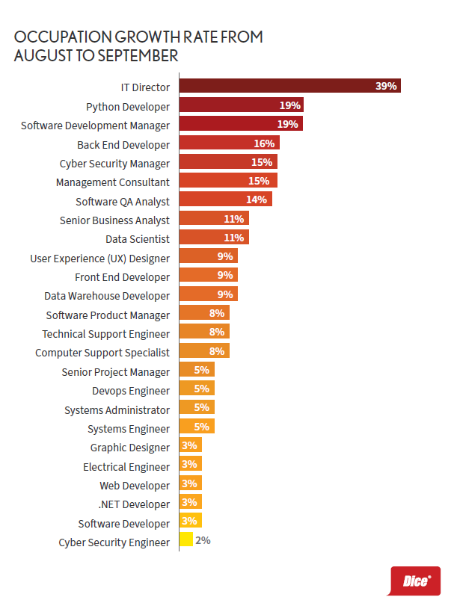
Data Science Job Market
Among the top 10 fastest growing jobs in 2020
Source: Top Jobs in Dice Tech Q3 Report

Slide 7



What is “Data Science”?
My Definition: The process of using data to (1) answer questions, (2) extract knowledge, and (3) predict future outcomes.
Examples:
Do people in college towns tend to buy more notebooks than people in other areas?
Find out top-10 sales categories for each age group.
Summarize product reviews w.r.t. product quality, customer service, etc.
If we recommend pens to users from college town, how much will it increase our revenue?”

Slide 8
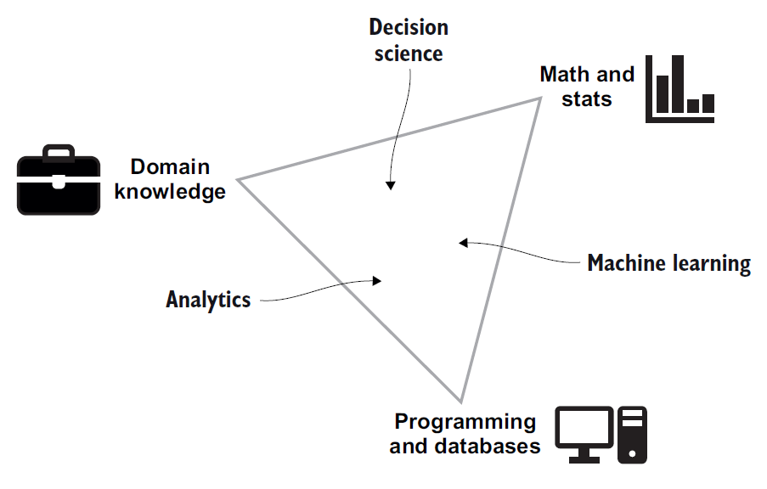
What is “Data Science”?
My Definition: The process of using data to (1) answer questions, (2) extract knowledge, and (3) predict future outcomes.
compute average/variance
design statistical models
amazon:
how customers behave
Caveat: I don’t love this figure since it leaves out visualization.
manufacturing:
how the process works
automate analyses
train models
manage data (store, retrieve)
[ Source: Robinson, E. and Nolis, J. ]
Data Science Is:
Interdisciplinary: Combines tools and techniques from Math / Statistics / CS
Exploratory: Understanding data requires creative exploration and visualization
Applied Statistics & Probability + extra stuff to handle, process, and visualize data

Slide 9
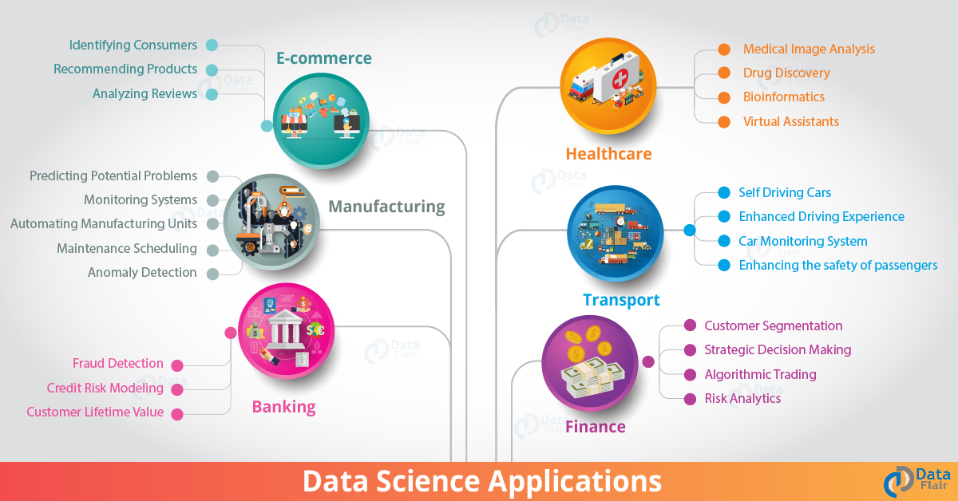

Slide 10
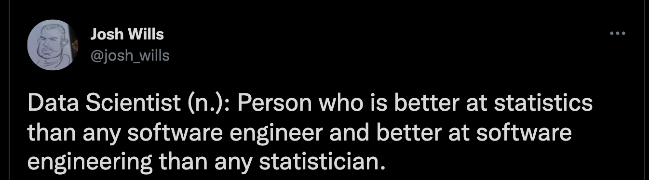
Who is a Data Scientist?
So, you should hone your statistical skills and your value will increase in the job market!!

Slide 11
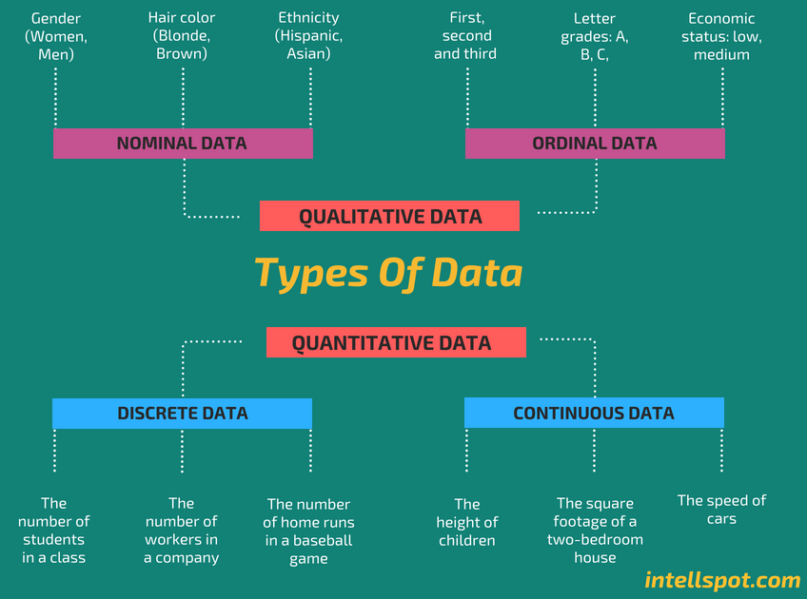
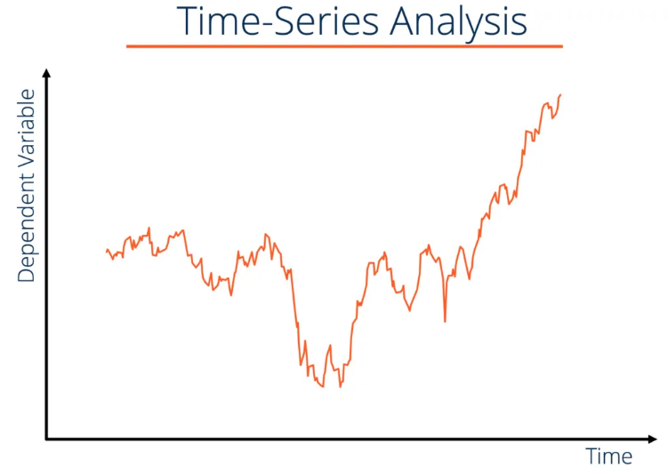
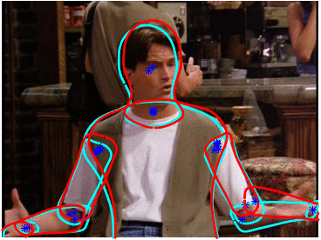
Types of Data
Data come in many forms, each requiring different approaches & models
Natural Language
Timeseries
Image / Video
The number of types is endless, these are just some examples

Slide 12
Data Science Workflow
Data Understanding
Data Collection / Processing
Visualize
Collect
Clean
Transform
Communicate
to your boss or client
Model
[ Adapted from: Grolemund and Wickham, 2018 ]

Slide 13
Case Studies

Slide 14

Moneyball
Problem How to assemble the best baseball team with a small budget?
Story about the Oakland Athletics baseball team and its general manager Billy Beane for 2002 Major League Baseball (MLB) draft
Traditional team building relies on scouts – but they are often biased and flawed.
SABRmetrics: Data-driven and evidence-based approach to player quality evaluation
On-base % and Slugging % are good indicators of offensive success
Players with these “features” are cheaper compared to traditional statistics (stolen bases, runs batted in, batting average)
On-base %: how frequently a batter reaches base
Slugging %: the total number of bases a player records per at-bat

Slide 15
Moneyball: Impact
In 2002 the Oakland Athletics ($44M budget) were competitive to the New York Yankees ($125M budget)
Toronto Blue Jays hired full-time sabermetric analysts
2020 season “masters of Moneyball” Tampa Bay Rays reached world series with the 3rd lowest salary of all MLB
In 2019 Liverpool Football/Soccer adopted this approach to nearly win the title (they lost to Manchester)
Brad Pitt got a paycheck out of it for the movie (7.6/10 IMDB)…

Slide 16
Election Forecasting: Disclaimer
This is a class about data science it is not a class about politics. We will discuss election forecasting only in the context of data science and we will ignore politics.

Slide 17
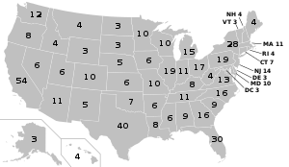
Election Forecasting
Problem Who will win the 2020 US presidential election?
Details
There are 2 primary candidates Donald Trump & Joe Biden*
The incumbent (Trump) is the sitting president
There are 50 states, each has a number of electors
Each elector has a vote in the electoral college
Electors for each state vote for the majority vote in that state
(Maine and Nebraska use a district method)
The winner has the majority of 538 electors (typically 270 or more votes)
[Wikipedia]
* Secondary candidates do not have a realistic chance of winning, but cannot be ignored since they affect votes for primary candidates
Notes:
district method: voters in each of the state's congressional districts select a single elector, with the two remaining electors being selected by the aggregate popular vote of the entire state

Slide 18
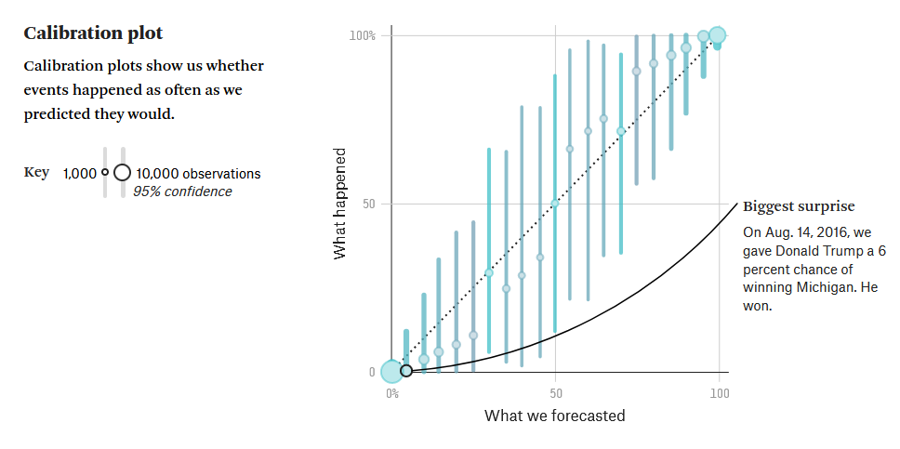

Election Forecasting: The Model
FiveThirtyEight uses a proprietary statistical model based on…
Weight accounts for poll sample size, timeliness, historical accuracy
Poll aggregation model
Additional model inputs
States grouped by demographic subcategories
Per capita income
Age distribution of residents
All features are significant to 85% level
Important properties of the model
Predictive statements are probabilistic
Assigns higher probability to extreme outliers
Accounts for correlation among states / polls
Notes:
the graph: probability of what you predicted vs probability of what really has happened.

Slide 19
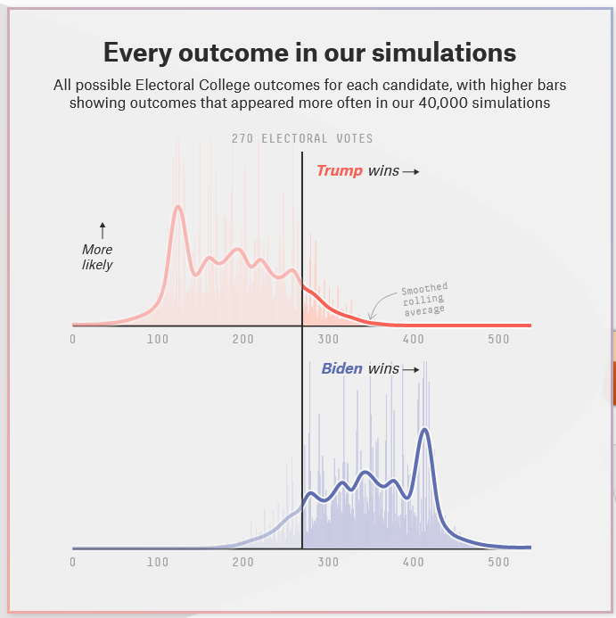
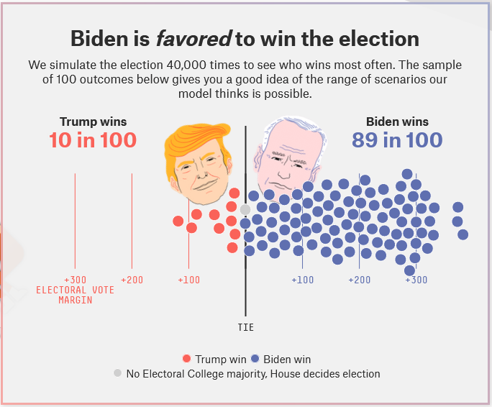
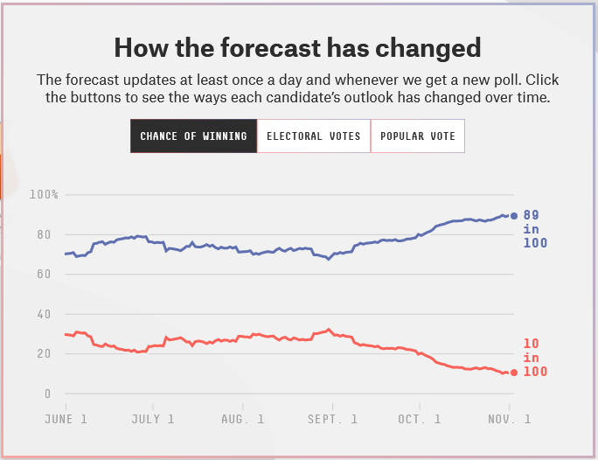
Election Forecasting: Visualizations
Generative (Bayesian*) model allows simulation of random realizations…
Click here to see visualizations
…visualizations targeted at communicating uncertainty about prediction.

Slide 20
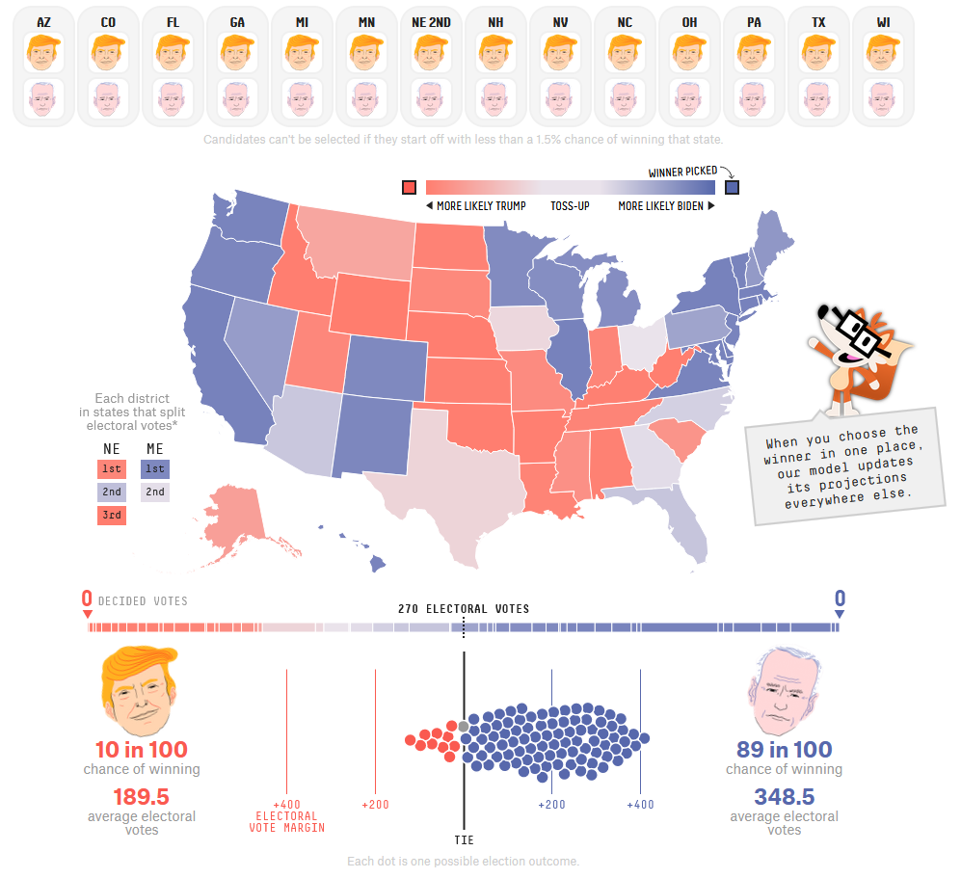

Election Forecasting: Exploratory Analysis
Model also allows “what if” (e.g. counterfactual) analysis…
…this is a feature of model interpretability.

Slide 21
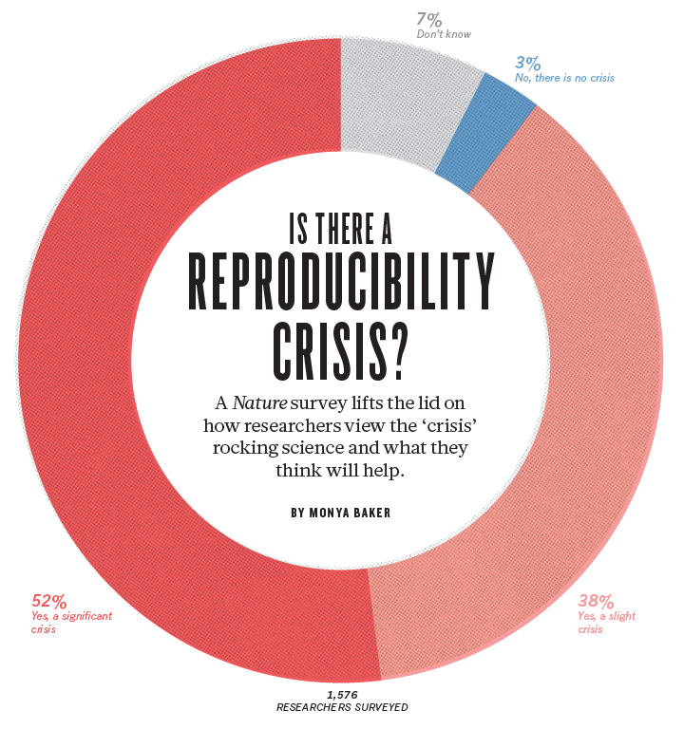
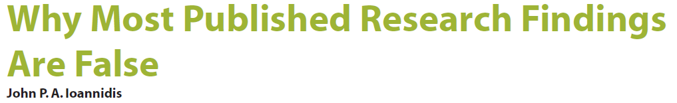

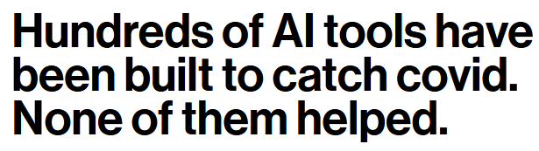
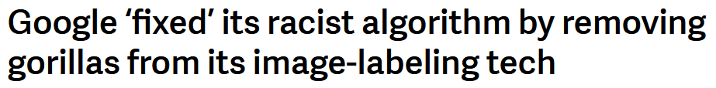
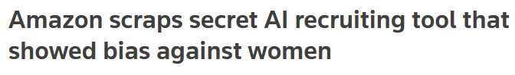


Bad Data Science & Statistics
In 2011 U. of V. Prof. Robert Novak started the “Reproducibility Project”
Crowdsourced project to reproduce statistical findings of 1,000 Psychology papers
Almost two-thirds (64%) findings are not reproducible
Initially in psychology, but also shown in physics, chemistry, biology, medicine, …

Slide 22









Programming Languages for Data Science
Python and R are both standard for data science these days
We will use Python for this course since you should already know it
↑ getting popular nowadays
Python Packages Covered
Other Useful Python Packages
Altair

Slide 23
Course Overview

Slide 24
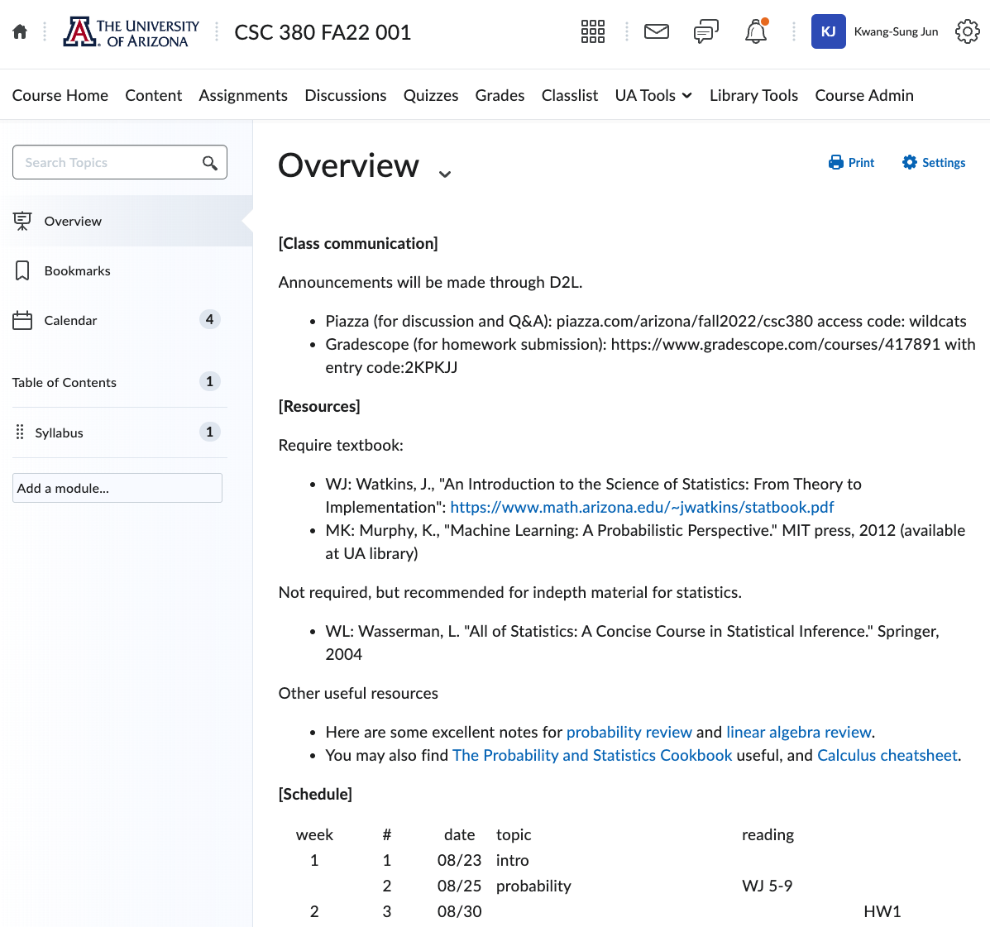
Course Overview: Resources
Resources accessible on D2L
Specific resources
gradescope for assignment submission
Piazza for discussions and Q&A.
Readings and electronic textbooks
Lecture slides (posted after class)
Every lecture accompanied by reading
These will not be graded but are recommended
Attendance is required
Recordings will be available after the class.

Slide 25
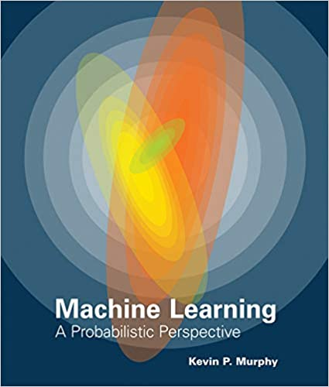
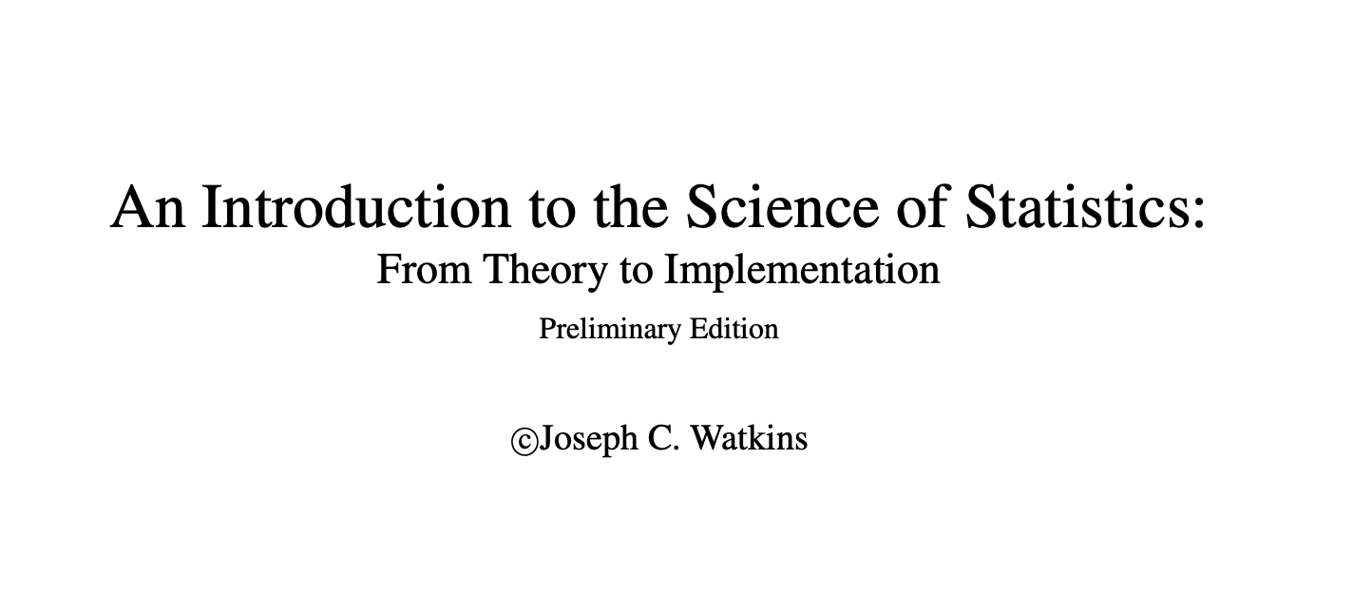
Textbooks
Watkins, J., "An Introduction to the Science of Statistics: From Theory to Implementation” (https://www.math.arizona.edu/~jwatkins/statbook.pdf)
Murphy, K. "Machine Learning: A Probabilistic Perspective." MIT press, 2012
( UA Library )

Slide 26


Course TA
Your friendly course TAs…
Tuan Ngo Nguyen
tnguyen9210@arizona.edu
Yang Hong
hong1@arizona.edu

Slide 27
Expected Skills
This class will use a fair amount of math
Probability and Statistics
Some Linear Algebra
These are not required background for the course, but you will learn key concepts in the class.
This class will require a fair amount of coding
Reading in / cleaning / visualizing data
Simulating random processes
Training and evaluating machine learning models
Early assignments will be mostly math, later will be coding

Slide 28

Expected Skills
Why probability/statistics?
Most statisticians are not good programmers.
By learning probability/statistics, your skill set will be rare and valuable.
The things that make a great job great, I discovered, are rare and valuable. If you want them in your working life, you need something rare and valuable to offer in return. In other words, you need to be good at something before you can expect a good job.
Newport, Cal. So Good They Can't Ignore You (pp. 13-14).

Slide 29
Course Overview
Course Objective Introduction to basic concepts in data science and machine learning.
Probability and Statistics | Data Handling and Visualization | Machine Learning
Random events / variables, distributions / densities, moments, descriptive stats, estimation | Reading & cleaning, transformation & preprocessing, visualization | Predictive models, supervised learning, unsupervised learning, model checking
↑ more on this in CSC 480/580

Slide 30
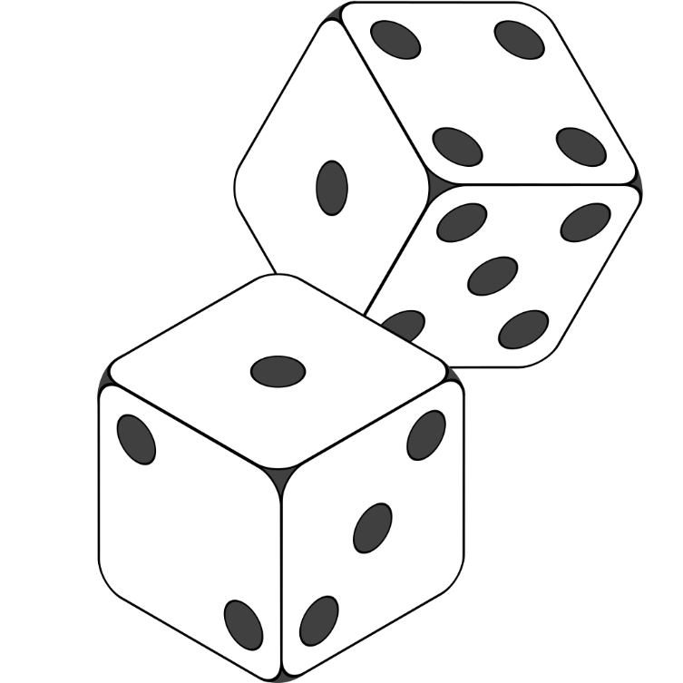
Probability and Statistics
fair die: each side is equally likely
Suppose we roll two fair dice…
What are the possible outcomes?
What is the probability of rolling even numbers?
… this is a random trial or random process.
We will learn how to…
Mathematically formulate outcomes and their probabilities?
Describe characteristics of random processes
Estimate unknown quantities (e.g. are the dice actually fair?)
Characterize the uncertainty in random outcomes
Identify and measure dependence among random quantities

Slide 31

Data Handling and Visualization
In Data Handling we will learn to…
Collect data
Identify and avoid biased population samples
Clean data and correct errors
Transform and preprocess data (wrangling)
[ Image Source: Code A Star ]
In Data Visualization we will learn…
Why visualization is important
Exploratory data analysis
Common forms of visualization
Pitfalls and gotchas
Notes:
gotchas: works as documented but is counter-intuitive and almost invites mistakes

Slide 32

Machine Learning
How to use data to learn underlying patterns and predict unknowns?
In Machine Learning we will learn…
Principles of prediction
Proper partitioning of training / validation / test data
Unsupervised vs. supervised learning
Linear and nonlinear models
We will preface this section with a Linear Algebra primer
[ Image Source: Towards Data Science ]

Slide 33
Assignments / Exams / Grading
7 Homeworks + Midterm + Project + Final Exam
Homeworks
Homeworks will be due in 8 days: e.g., out on Thursday, due on next Friday.
You can do HWs individually or in pairs, but you must contribute equally for each question if working in pairs
Grading will be available in 7 days excluding weekends/holidays.
The HW with the lowest score will be dropped
Grading Breakdown
Assignments: 36% (6% each)
Midterm: 20%
Project: 14%
Final Exam: 20%
Participation: 10%
First assignment out next Tuesday

Slide 34
Late Policy
Late submissions impact other students, delay grading, and delay solutions
No late submission policy
Late submissions are not accepted, period.
Strongly recommend that you plan to submit your work a day earlier.

Slide 35

Project
It is a previous Kaggle competition.
A guided project. You will answer given questions, including some open questions.
You will get a change to try out various ML algorithms and get high accuracy.
For top 10%, extra score (+2%).

Slide 36
Communication
Announcements will be made via D2L
Homework submission: gradescope (see course website for the link)
Make sure your gradescope email address is the same as your D2L’s
Piazza (see D2L for the link): we highly encourage that you ask and answer questions among yourselves.
We will chime in often.
You can also ask questions directly to us if it is personal.
Otherwise, please make the question as a public post so other students can benefit from it.

Slide 37
Office Hours
Office hours will be held both in person and zoom, and the zoom link will be accessible via D2L
1hr by the instructor, once a week.
1hr by each TA, once a week.
The final office hour schedule will be announced at the end of this week.
If you have a conflict with the schedule, let me know (Piazza)

Slide 38
Academic Integrity
Assignments are to be done independently, unless explicitly marked as a collaborative homework.
If I or the TA suspects you of having cheated
You will be notified immediately
We will have a conference where you can plead your case
If I am not swayed then you will get an F grade, period.
To avoid any unconscious cheating, you must write down who you have worked with and to what degree you got help, outside your group.
Bottom line: don’t cheat

Slide 39
Homework
Let’s see your preferences.
Collaborative? (say 3 people per group)
Or individual?
(Even if it is collaborative, you will have to do you own homework, and you must understand your own answer. It just means that you can answers within your group)

Slide 40
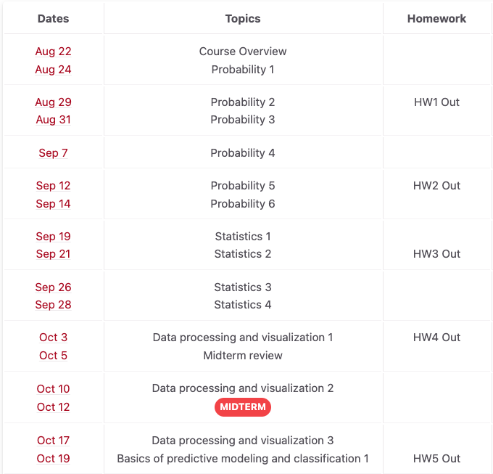
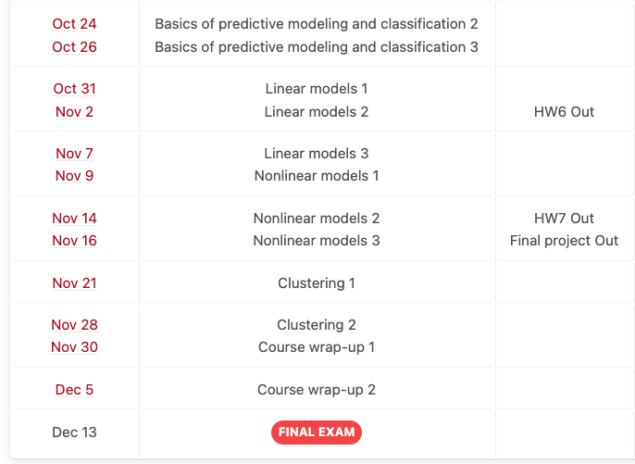
Full Course Schedule (Tentative)
Tentatitve; We will constantly update the schedule page March 7, 9: Spring Recess

Slide 41
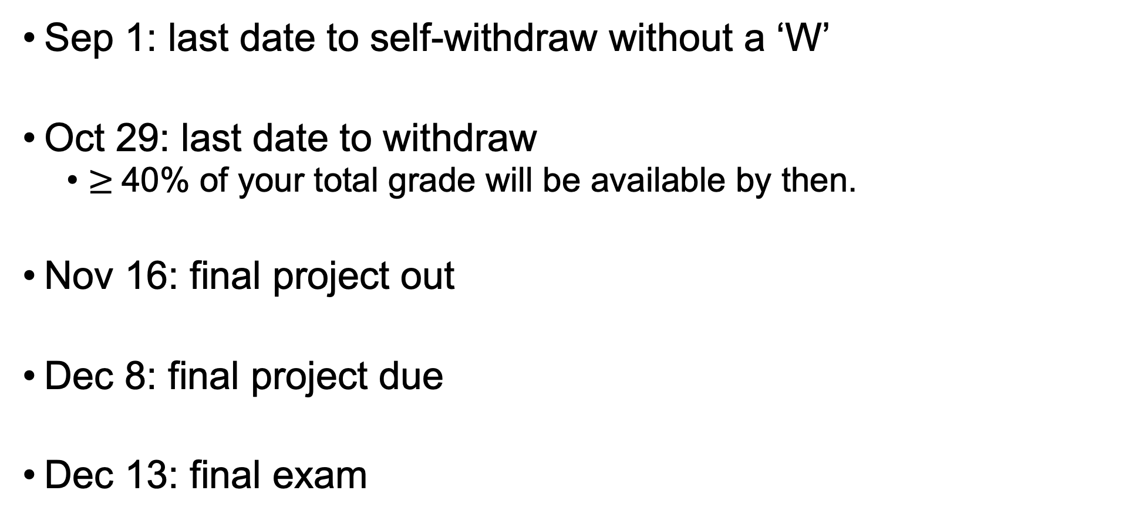
Important Dates
Sep 1: last date to self-withdraw without a ‘W’
Oct 29: last date to withdraw
$≥$40% of your total grade will be available by then.
Nov 16: final project out
Dec 8: final project due
Dec 13: final exam

Slide 42
Mental Wellbeing
Some occasional stress / depression / anxiety is normal, but sometimes you may need extra help
Non-emergency UA resources at Counseling & Psych Services Mon-Fri
Phone: 520-621-3334
Web: https://health.arizona.edu/counseling-psych-services
Emergency resources in Tucson in this Google Doc

Slide 43
Inclusivity
We want to foster a comfortable and inclusive classroom experience
Please let me know if you feel excluded in any way, e.g.
Improper use of pronouns
Microagressions
Miscellaneous statements / interactions
You can message us on Piazza or discuss in person

Slide 44
Reading Assignments
For the next lecture: Watkins book Section 5 and 6
‘Probability and statistics cookbook’ is a good cheat sheet. Download it from http://statistics.zone/

